Slide 1
TypeScript
Classes and Interfaces
Lecture 3
By James(Jin) Wang
09/15/2019

Slide 2
Outline
Defining Classes
Extending Types
Using Interfaces
Extending an Interface

Slide 3
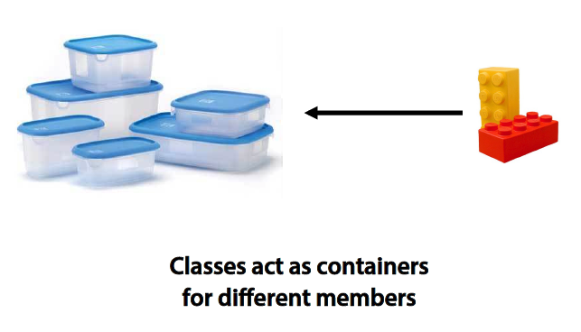
Defining Classes
  The Role of Classes in TypeScript:

Slide 4
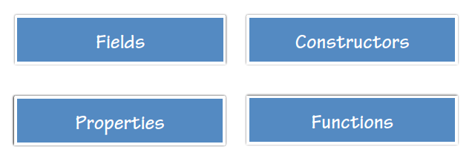
Defining Classes
  TypeScript Class Members:

Slide 5
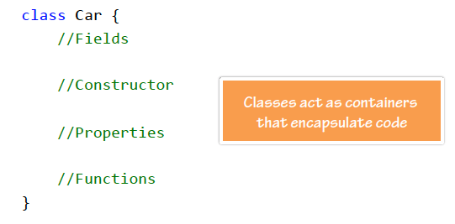
Defining Classes
  Defining a Class:

Slide 6
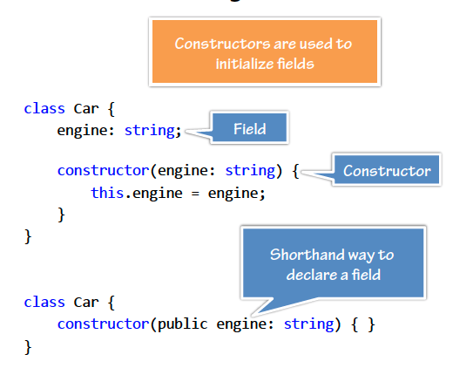
Defining Classes
  Defining Constructors:

Slide 7
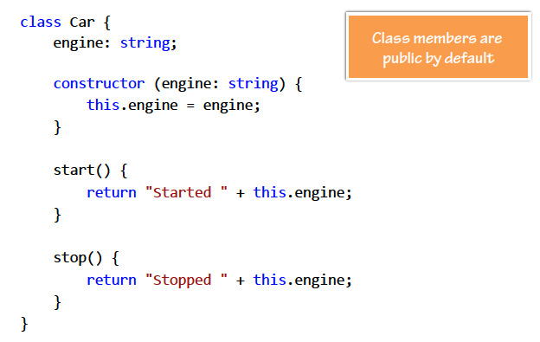
Defining Classes
  Adding Functions:

Slide 8
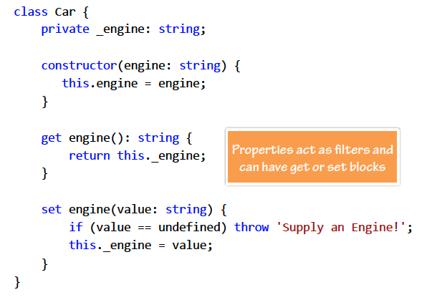
Defining Classes
  Defining Properties:

Slide 9
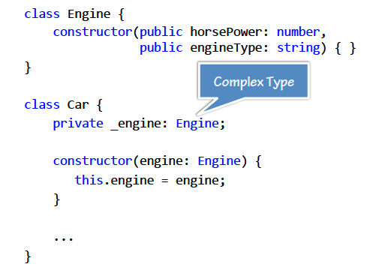
Defining Classes
  Using Complex Types:

Slide 10
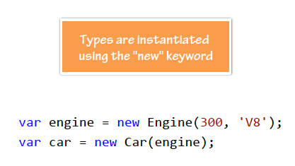
Defining Classes
  Instantiating a Type:
  Demo: Defining Classes

Slide 11
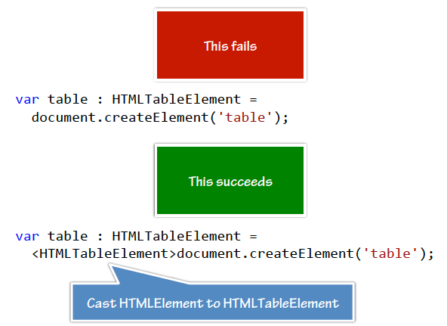
Defining Classes
  Casting Types:

Slide 12
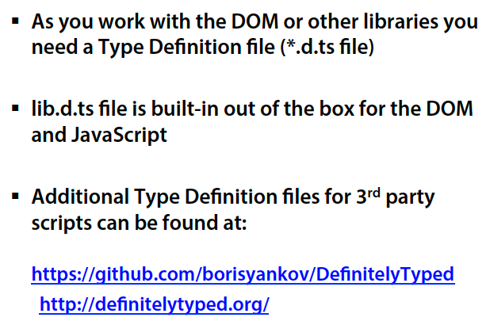
Defining Classes
  Type Definition Files:
  Demo: HelloWorld Calculator

Slide 13
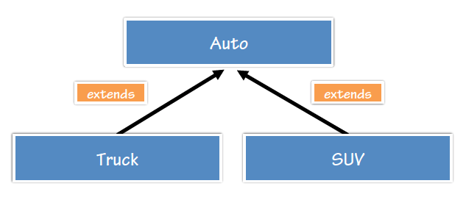
Extending Types
  Extending Types with TypeScript:

Slide 14
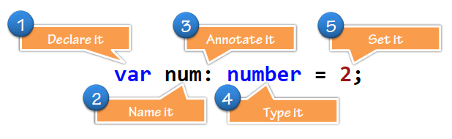
Grammar, Declarations and Annotations
  Grammar: Type Annotations:

Slide 15
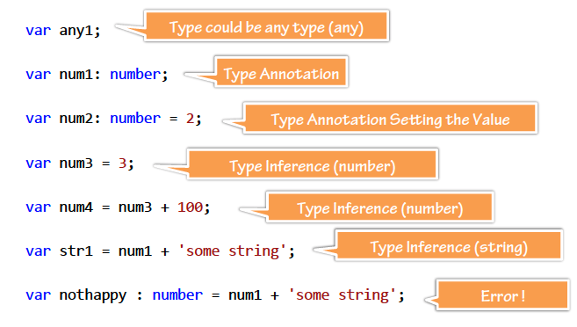
Grammar, Declarations and Annotations
  Annotations and Inferences:
  Demo: Grammar
  Demo: Timer

Slide 16
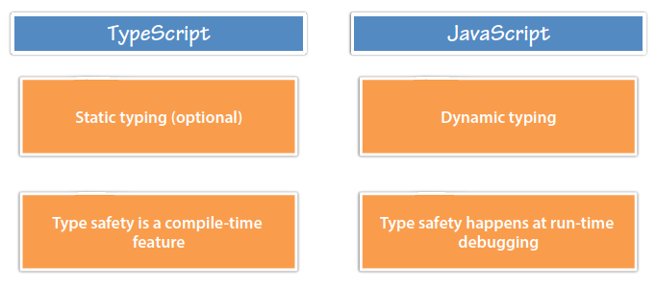
Typing and Ambient Declarations
  Dynamic and Static:

Slide 17
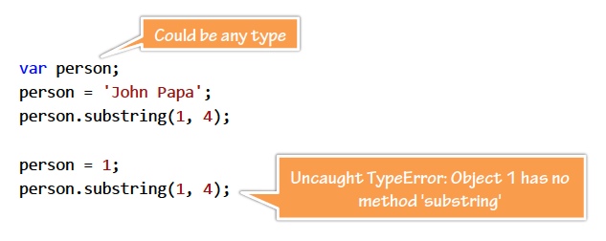
Typing and Ambient Declarations
  JavaScript’s Dynamic Types:

Slide 18
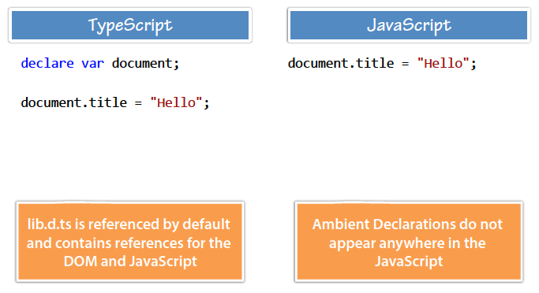
Typing and Ambient Declarations
  Ambient Declarations:

Slide 19
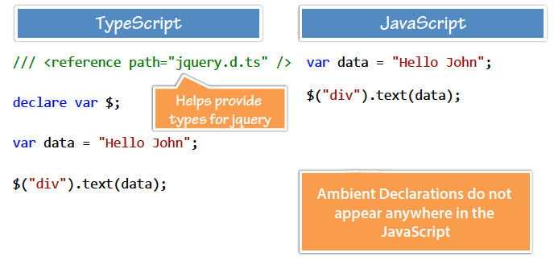
Typing and Ambient Declarations
  Type Definition Files:
  Demo: Dynamic Types
  Demo: Ambient Declarations

Slide 20
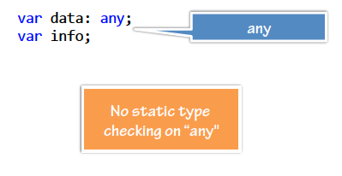
Any and Primitive Types
  Any:
  Represents any JavaScript value

Slide 21
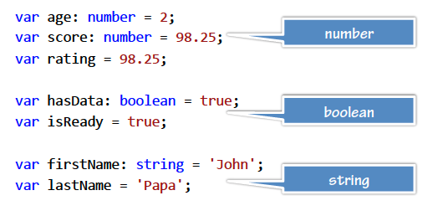
Any and Primitive Types
  Primitive Types:

Slide 22
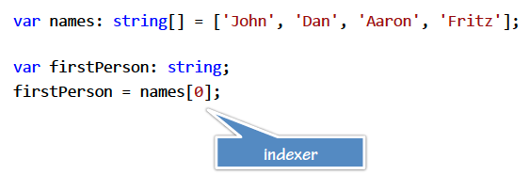
Any and Primitive Types
  Arrays and Indexers:

Slide 23
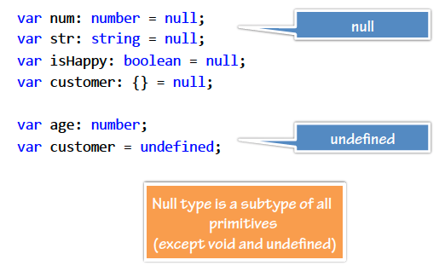
Any and Primitive Types
  Primitive Types - Null:

Slide 24
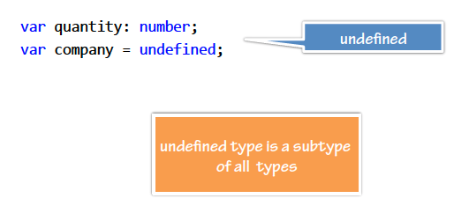
Any and Primitive Types
  Primitive Types - Undefined:
  Demo: Primitives

Slide 25
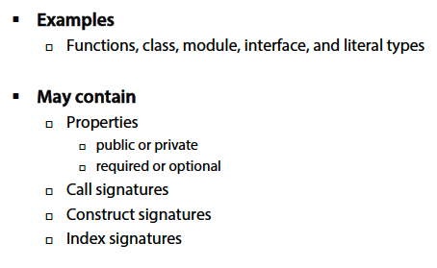
Object Types
  Object Types:

Slide 26
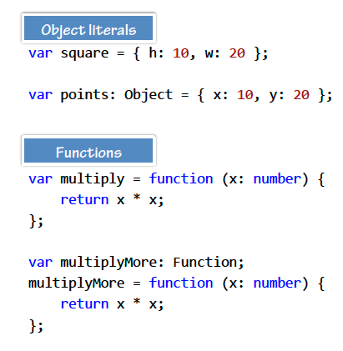
Object Types
  Object Types:
  Demo: Objects

Slide 27
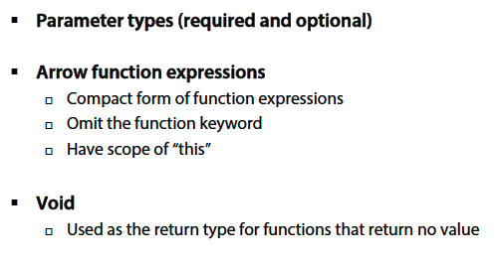
Functions
  Functions:

Slide 28
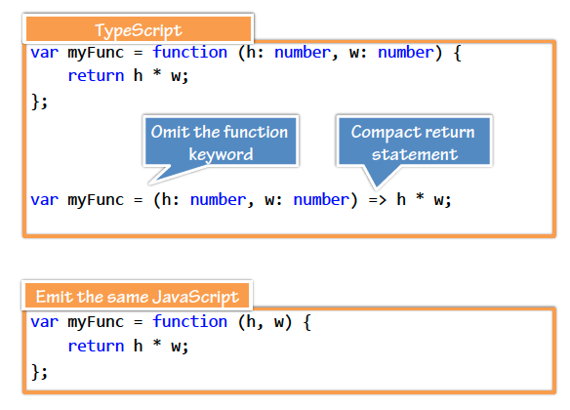
Functions
  Arrow Function Expressions:

Slide 29
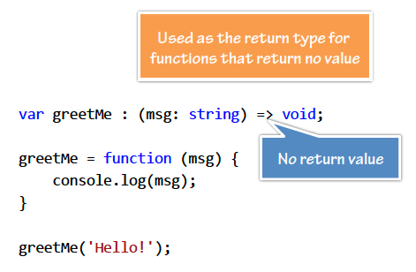
Functions
  Void:
  Demo: Functions
  Demo: Interfaces

Slide 30
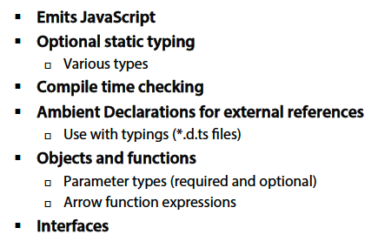
Summary

